Slide 1
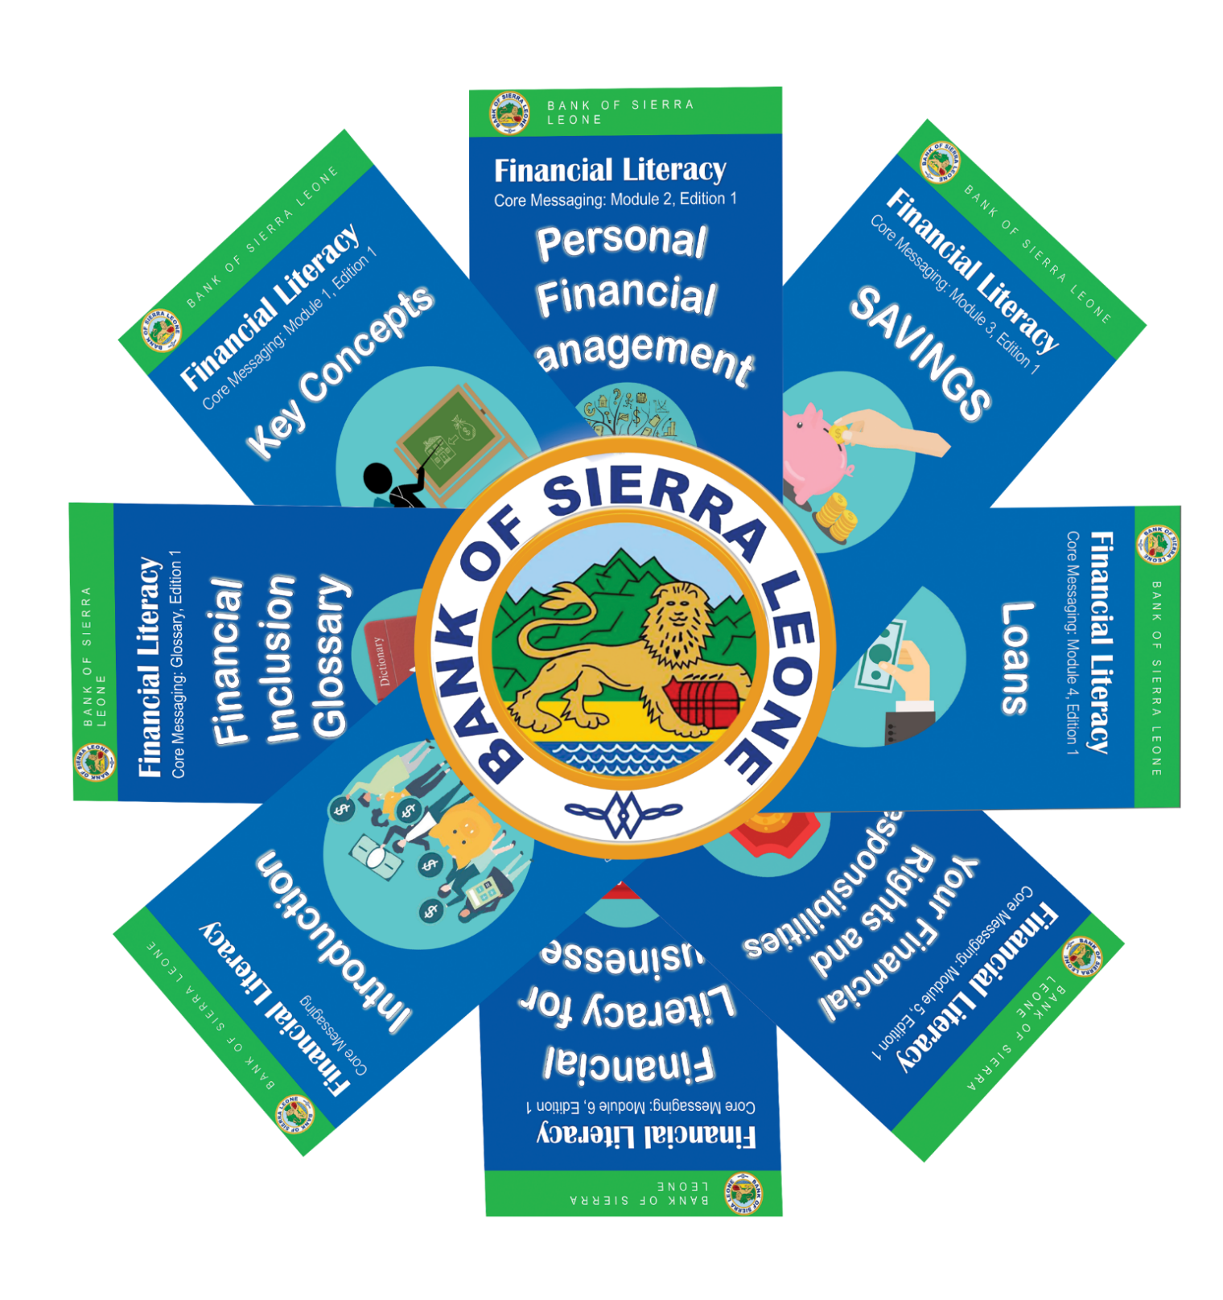
New Governor of the Bank of the Sierra Leone appointed
New Deputy Governor of the Bank of Sierra Leone appointed.
BSL participated in technical workshops to advance financial inclusion
The Bank of Sierra Leone has completed the implementation of the Geospatial Project
BSL to commence the implementation of the Youth Entrepreneurship Fund (YEF)
The Bank of Sierra Leone to commence Market Conduct Supervision
BSL celebrated International Credit Union Day with NaCCUA-SL
BSL participated in the Alliance For Financial Inclusion(AFI)’s 2023 Global Policy Forum (GPF)
BSL developed and published Financial Literacy Messages
Bank of Sierra Leone participated in IFAD Supervision Mission for the Rural Finance and Community Improvement Project (RFCIP 2) 4th- 8th December 2023.
Creating an enabling regulatory environment for financial inclusion
Bank of Sierra Leone Bided Farewell to the ODI Consultant and outgoing UNCDF Representative attached to the BSL
Financial Inclusion Expert’s Corner: Insights & Resources- Understanding Money – Read Financial Literacy Messaging, Module 1 for more details
BSL Financial Inclusion Crosswords Puzzle Game
Looking forward – upcoming financial inclusion activities
Financial Literacy Messages

Slide 2
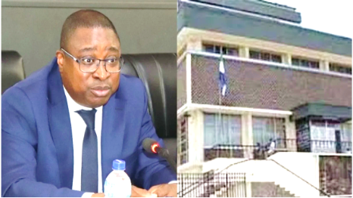
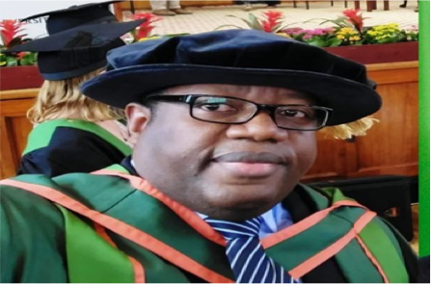
BSL EVENTS: NEW GOVERNORS APPOINTED
New Governor of the Bank of Sierra Leone Appointed.
Dr. Ibrahim L. Stevens, has been appointed as the new Bank Governor following parliamentary approval. He previously served as the Acting Governor of the Bank of Sierra Leone, a position he held since March 2023. He was initially appointed as Deputy Governor in July 2014 and was reappointed for a second five-year term in 2019.
In his role as Deputy Governor at the Bank of Sierra Leone, Dr. Stevens has led several reforms at the BSL, including the modernization of the conduct of monetary policy and implementation, policy development of financial system stability, currency management, financial inclusion and digital financial services and payments system architecture, among others. He was also pivotal in the establishment of the BSL Fintech Challenge and Sandbox Program, which was one of the first in the sub-region and had received much international acclaim.
As Acting Bank Governor, Dr. Stevens assumed a position of great responsibility, overseeing the financial well-being and future prospects of the Bank.
Dr. Ibrahim L Stevens, Governor, Bank of Sierra Leone
Throughout his illustrious career, Dr. Stevens has exhibited exceptional leadership, vision, and a steadfast dedication to the principles of sound financial governance. His deep insights and astute decision-making have played a pivotal role in navigating our institution through periods of both stability and change, and we are confident that he will continue to lead with the same level of expertise and commitment.
New Deputy Governor of the Bank of Sierra Leone Appointed.
Dr. Joseph A. Tucker has been appointed as the Deputy Governor, Monetary Stability at the Bank of Sierra Leone following parliamentary approval.
The Deputy Governor’s responsibilities include contributing to the formulation and implementation of monetary policies aimed at sustaining economic growth and stability.
As Sierra Leone navigates economic challenges and strives for monetary stability, Dr. Tucker’s appointment underscores the Bank’s commitment to fostering a robust monetary and financial environment.
Dr. Joseph A Tucker, known for his expertise in economic affairs, will bring a wealth of experience to this pivotal role.
Dr. Joseph A Tucker , Deputy Governor, Monetary Stability, Bank of Sierra Leone
The Bank is optimistic about this appointment, as it aligns with the Bank’s vision for a resilient and prosperous economic future.

Slide 3
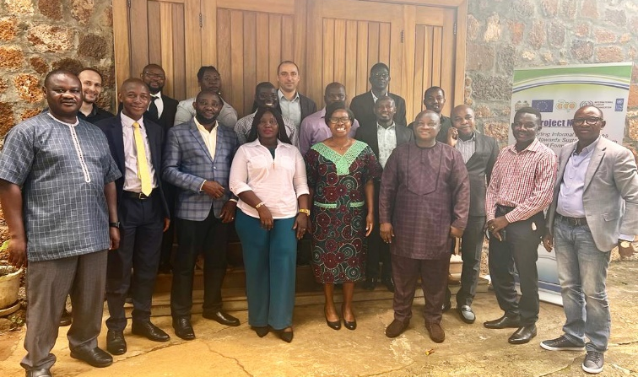
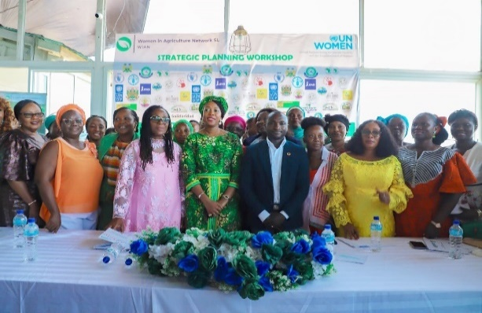
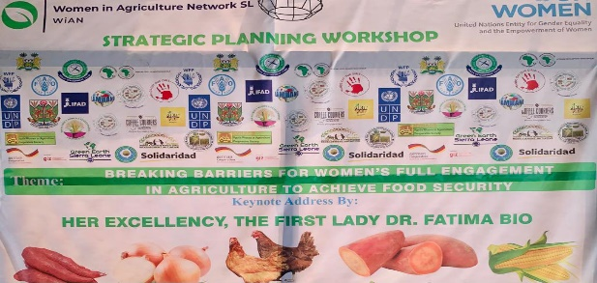
BANK OF SIERRA LEONE PROMOTING FINANCIAL INCLUSION BY PARTICIPATING IN STRATEGIC WORKSHOPS
BSL participated in a Workshop on the formalization of the informal sector.
The International Labor Organization (ILO) in collaboration with the United Nations Development Program (UNDP) organized a one-day workshop on the theme “How can financial services facilitate transition from the informal to the formal sector in Sierra Leone”. The workshop aimed to support the development and implementation of favorable regulatory conditions and relevant incentives for businesses to formalize by inviting ideas from stakeholders both in the formal and informal sectors, in particular, the central bank and financial service providers that can create favorable conditions for formalization. The workshop also attracted participants from non-governmental organizations, ministries, departments and agencies, and civil society organizations to discuss barriers to formalization.
Cross –section of participants at the workshop
Bank of Sierra Leone Joined WiAN in a Strategic Planning Workshop
The Women in Agriculture Network Sierra Leone (WiAN-SL) invites BSL to a two-day strategic planning workshop to brainstorm opportunities that empower women for sustainable agricultural development, thereby promoting food security in rural communities and improving the livelihood and socio-economic status of women and the vulnerable population across the Country.
The workshop stressed the importance of financial inclusion and access to finance, especially for women in the agricultural sector and individuals with disabilities. It was launched by the First Lady of the Republic of Sierra Leone – H.E. Dr. Fatima Jabbie Maada Bio.
In attendance were representation from the formal and informal sectors, i.e. the central bank, financial service providers, non-governmental organizations, ministries, departments and agencies, and civil society organizations.
H.E. Dr. Fatima Bio, the First Lady of the Republic of Sierra Leone and Cross –section of participants at the workshop

Slide 4
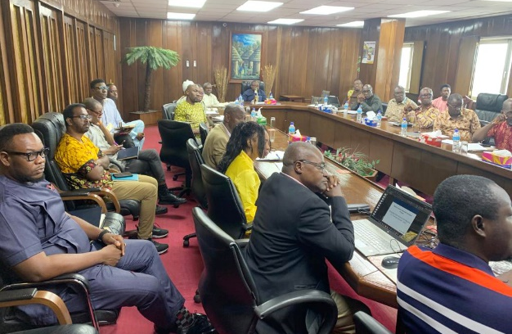
THE BANK OF SIERRA LEONE HAS COMPLETED THE IMPLEMENTATION OF THE GEOSPATIAL PROJECT
As part of the implementation of the National Strategy for Financial Inclusion 2022-2026, the World Bank in December 2022 supported the Bank of Sierra Leone in recruiting a consultant to update the current database on financial access points from all regulated financial institutions; develop an interactive dashboard of access points visualized at both district and chiefdom levels and design, develop and operationalize a mobile app to continuously update the financial access points.
The project has been completed and results were presented to the management of the Bank of Sierra Leone (BSL) on Thursday 28th September 2023. Training on the project was also conducted for the staff of the Bank and the Financial Service Providers (FSPs).
The project's final report has been presented to the BSL and relevant stakeholders. Operationalization of the interactive dashboard and mobile app to continuously update the financial access points has commenced.
Cross –section of staff of BSL during the presentation to Management by the Consultant
BSL TO COMMENCE THE IMPLEMENTATION OF A YOUTH ENTREPRENEURSHIP FUND (YEF)
The Bank of Sierra Leone in 2022/2023, developed a concept note for the development of a Youth Entrepreneurship Fund as part of implementing the National Strategy for Financial Inclusion 2022-2026. The concept note was developed in collaboration with the relevant Departments/Units in the Bank as well as key stakeholders in the financial sector. Key objectives of the YEF are to:
(a) increase youth employment and empowerment through funding of promising youth-owned/managed/focused enterprises and entrepreneurs;
(b) increase access to finance for youth-led MSMEs and start-ups through affordable financial products and services that are targeted and client-centric; and
(c) foster an enabling environment conducive to innovation and MSME development by embracing and investing in new ideas, and start-ups and capitalizing the ecosystem.
The YEF will also contribute to broader national priorities to improve lives through education, inclusive growth and building a resilient economy. It will also contribute to the global sustainable development goals to reduce poverty and inequalities and promote economic growth and jobs.
The operating rules for the Fund have been developed and implementation will soon commence.

Slide 5
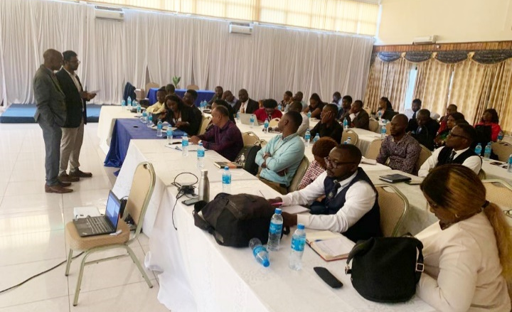
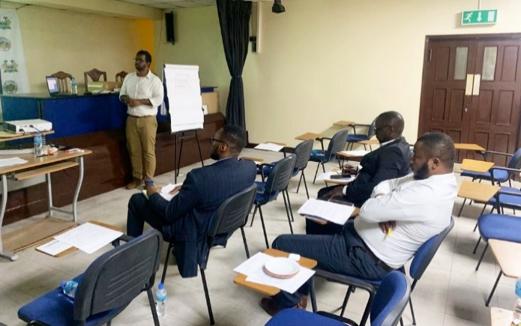
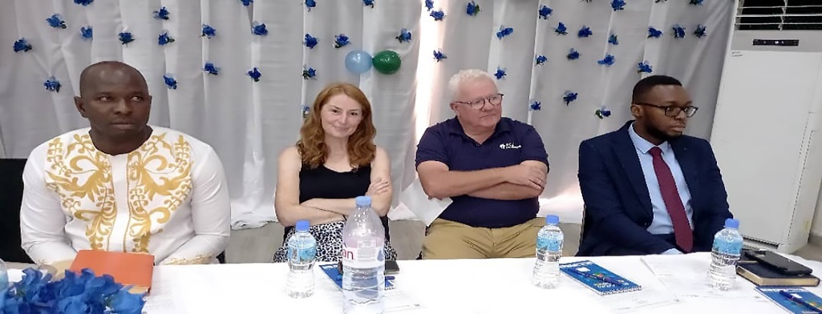
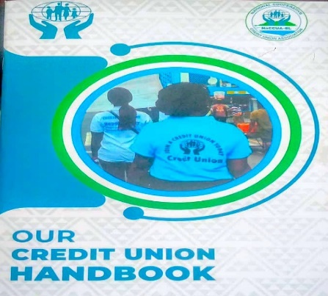
THE BANK OF SIERRA LEONE TO COMMENCE MARKET CONDUCT SUPERVISION
A Manual for Market Conduct Supervision was developed by the Bank with technical support from the Alliance for Financial Inclusion (AFI) and key stakeholders in the financial sector. The objective of the Manual is to promote fair competition, transparency, financial stability support consumer protection. The Manual complements the Financial Consumer Protection Guidelines which was launched in 2022 by the Bank and will be used by the Other Financial Institutions Supervision Department (OFISD) and Banking Supervision Department (BSD) in supervising the Financial Service Providers (FSPs). The manual has been finalized and the Bank is currently developing an instrument that will ensure that the Financial Service Providers comply with the provisions in the manual.
Cross –section of participants during a presentation on the Manual
Cross –section of participants during a presentation on the Manual
BSL CELEBRATED INTERNATIONAL CREDIT UNION DAY WITH NaCCUA-SL
National Cooperative Credit Union Association-Sierra Leone (NaCCUA-SL) in collaboration with the Irish League of Credit Union Foundation (ILCUF), German Sparkassenstiftung Eastern Africa (DSIK), and the Department of Cooperatives-Ministry of Trade organized a one-day celebration of the International Credit Union Day at the New Brookfields Hotel, Freetown. The day served as a momentous occasion to celebrate the essence of the global credit union movement, reflecting upon its historical journey, remarkable achievements, diligent efforts, and valuable experiences of its members. During this occasion, the first National Credit Union Handbook was also launched. NaCCUA focuses on raising awareness about the commendable endeavors undertaken by credit unions and other financial cooperatives across the country and also encourages higher membership engagement. NaCCUA currently boasts of a membership of 27 credit unions, serving diverse communities of over 15,000 members throughout the country, with accumulated savings and shares exceeding Le 20,000,000. This year’s theme was: “Empower your financial future with a Credit Union”.

Slide 6
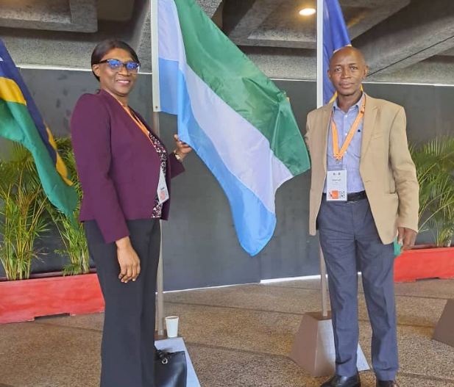
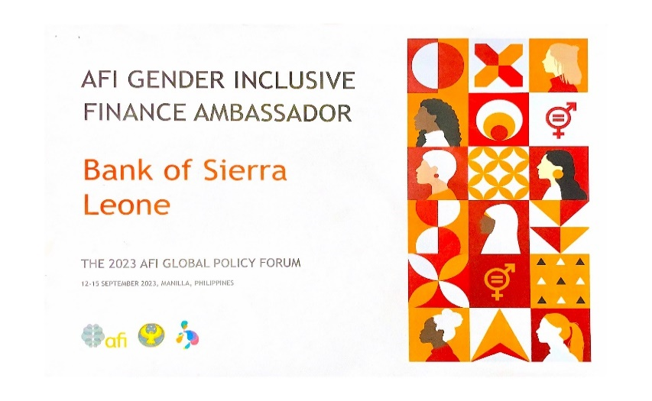
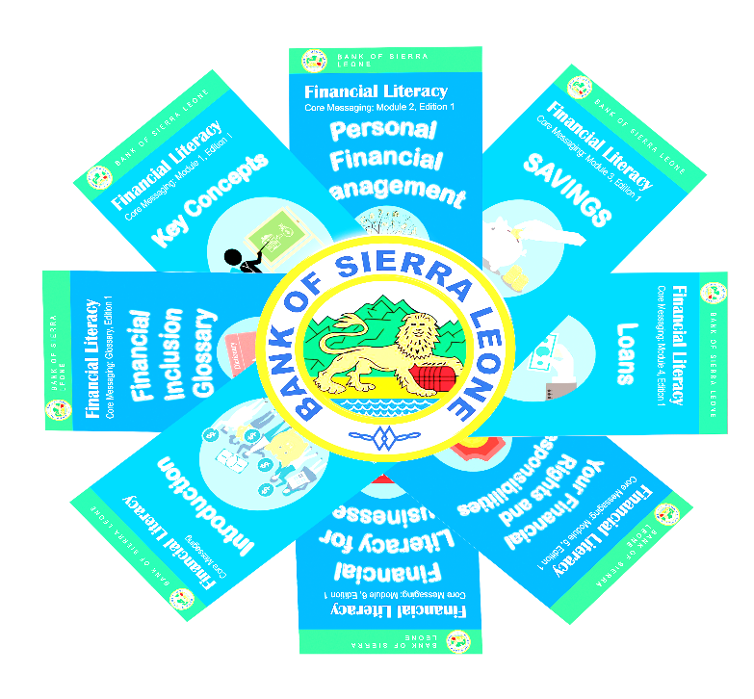
BSL PARTICIPATED IN THE ALLIANCE FOR FINANCIAL INCLUSION(AFI)’s 2023 GLOBAL POLICY FORUM (GPF)
Bank of Sierra Leone was awarded AFI Gender Inclusive Finance Ambassador
At the recent flagship annual Global Policy Forum (GPF) and Annual General Meeting in Manilla - Philippines, organized by the Alliance for Financial Inclusion (AFI) and co-hosted by the Bangko Sentral ng Pilipinas (BSP), the Bank of Sierra Leone was recognized for its tremendous efforts in promoting gender-inclusive finance. To this end, the Bank was awarded a certificate as AFI Gender Inclusive Finance Ambassador and was highly applauded for its financial inclusive efforts. The theme for the event was “Stability, Sustainability, and Inclusivity for Shared Prosperity”. The theme explored the role financial inclusion plays in the monetary and financial stability mandates of AFI members. It also reflects on the common obligation to make socio-economic progress relevant and resonant for all, particularly the most financially disadvantaged. The discussion also turns a spotlight on the importance of capitalizing on the transformational impact of technology, while keeping its risks in check, thereby ensuring that no one is left behind.
The Director-Secretary’s Dept.(left). & The Head /Assistant Director, FSDU, BSL
BSL RECENTLY DEVELOPED AND PUBLISHED FINANCIAL LITERACY MESSAGES TO IMPROVE FINANCIAL LITERACY AND EDUCATION IN SIERRA LEONE
In implementing the financial education, financial literacy, and consumer protection components in the National Strategy for Financial Inclusion 2022-2026, the Bank recently developed Financial Literacy Messages. The messages were developed in collaboration with the relevant departments/units in the Bank, as well as key stakeholders. The objective of the messages is to ensure uniformity in the dissemination of financial literacy messaging to the public by stakeholders in the financial inclusion space.
These messages are clear and simple statements, guidelines, and advice for individuals and businesses to better understand financial concepts and to become more successful and empowered. They also focus on key topics for the foundational understanding of personal financial management. They consist of (8) different messages and will be added or revised when necessary.

Slide 7
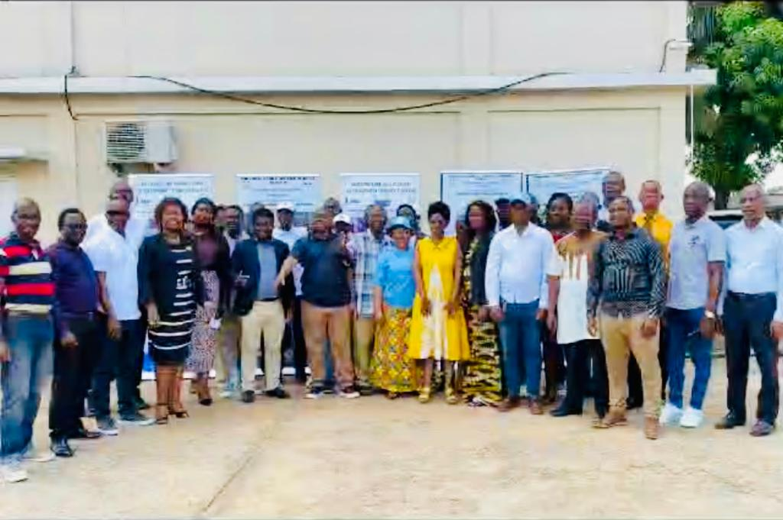
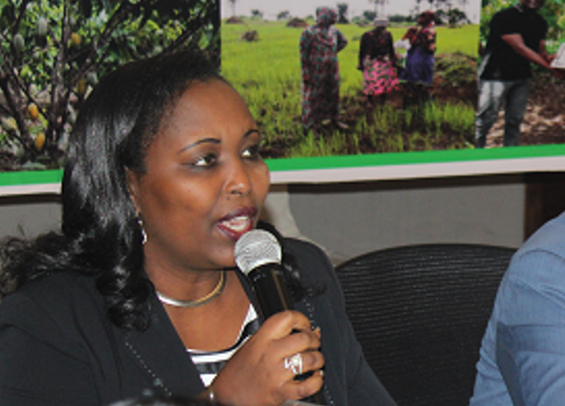
BANK OF SIERRA LEONE PARTICIPATED IN IFAD SUPERVISION MISSION FOR THE RURAL FINANCE AND COMMUNITY IMPROVEMENT PROJECT (RFCIP 2) 4TH- 8TH DECEMBER, 2023.
.
The Bank of Sierra Leone participated in IFAD’s supervision mission to Sierra Leone to assess the progress of the last supervision mission and to ascertain the speed of implementation in anticipation of additional funding. The meeting held at the National Program Coordination Unit (NPCU) in Bo City was hybrid (virtual 4 and field 1) comprising of relevant IFAD experts led by Ms. Pascaline Barankeba, IFAD’s Country Director for Sierra Leone and Liberia. There were representatives from Apex Bank, the Ministry of Agriculture, and the Ministry of Finance.
Meetings were held with the Community Bank (CB), Financial Services Association (FSA), and customers/beneficiaries of the services offered by these banks (women, men, and youths). To continue fostering Financial Inclusion, recommendations were made for capacity building for the demand side (recipients of the loan) and supply side (Rural Finance Network).
At the meeting, the majority of the shareholders and beneficiaries interviewed by the IFAD consultants intimated that the operations of the Rural Finance Institutions have impacted positively on their lives, families, businesses, and professions.
.
Cross section of representatives at the mission
Ms. Pascaline Barankeba, IFAD’s Country Director for Sierra Leone and Liberia
CREATING AN ENABLING REGULATORY ENVIRONMENT FOR FINANCIAL INCLUSION
THE FOLLOWING DOCUMENTS HAVE BEEN PUBLISHED IN THE SIERRA LEONE GAZETTE:
Redenomination of the Leone – End of the Transition Period
Guidelines on Corporate Governance for Commercial Banks and Financial Holding Companies 2023

Slide 8
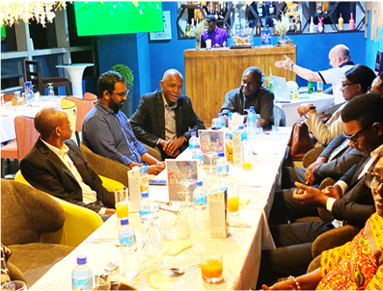
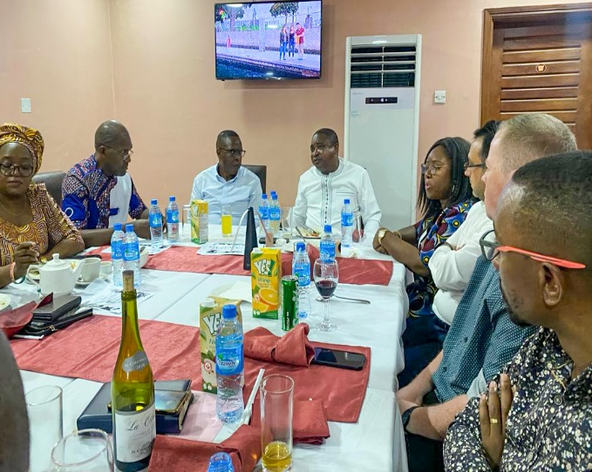
BANK OF SIERRA LEONE BIDED FAREWELL
End of Contract for the ODI Consultant assigned at the FSDU-BSL
The Bank of Sierra Leone (BSL) in 2021 recruited a Financial Inclusion Specialist (Overseas Development Institute Fellow-ODI Fellow), Mr. James Thalla – Joel to support the implementation of its financial inclusion projects. The recruitment process was done in partnership with the Overseas Development Institute (ODI) through their Fellowship Scheme. The Consultant was recruited for a two-year period, effective October 2021 and he was based in Freetown, Sierra Leone. His contracted period ended in October 2023
As the Bank bids him farewell, he will be greatly remembered for his pivotal role in the development and implementation of the current National Strategy for Financial Inclusion 2022-2026, and other projects.
Staff of the Bank of Sierra Leone having farewell dinner with the ODI Consultant
BSL hosted a Lunch with outgoing UNCDF Representative
In a lunch hosted by the Bank of Sierra Leone with the outgoing UNCDF Representative in Sierra Leone - Mr. Wycliffe Ngwabe, the Bank reflects on the impacts, collaborations, and friendship with the outgoing UNCDF Rep.
As we bid farewell to a significant chapter, we pause to reflect on the impacts, the journey shared, the experiences, and what we have encountered.
Mr. Ngwabe has served as the BSL Financial Inclusion Consultant for five years, in which he participated in the implementation of the National Strategy for Financial Inclusion 2017-2020 and the development of the second National Strategy for Financial Inclusione –NSFI 2022-2026. He also worked with the Sierra Leone Fintech Challenge 1 & 2, the BSL Sandbox committee, and many other projects.
The Bank is profoundly grateful and hopes that our journey’s legacy extends beyond the immediate moment. We wish him well in his future endeavors.
Management of the Bank of Sierra Leone having a farewell lunch with the UNCDF Team

Slide 9
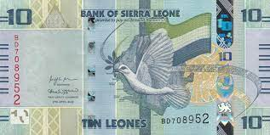
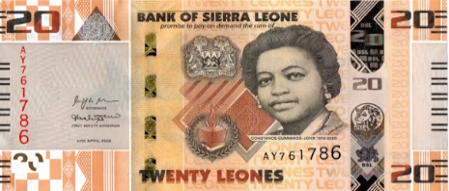
FINANCIAL INCLUSION EXPERT’S CORNER: INSIGHTS & RESOURCES
WHAT IS MONEY?
Wetin na mɔni
We talk about and use money every day – but have you stopped to think about what exactly is money? It is important to understand the features of money so you know what is considered and not considered as money.
Three features of money:
Tri yuz ɔf mɔni
Medium of exchange – money can be exchanged for goods or services
Store of value – over time, money still has some value
A measure of value – money provides a common way to value goods and services
The most common form of money is paper notes and/or coins –
in Sierra Leone, we call it the Leone.
WHERE DOES MONEY COME FROM?
Usay mɔni de kɔmɔt
The Government of a country is responsible for creating the country’s money supply. Most commonly, a country has a Central Bank which is responsible for creating and managing the money.
In Sierra Leone, the central bank is called the Bank of Sierra Leone.
When money is printed or minted, there will be key features to show that the money is real and not fake:
LOOK
for distinct visual features (e.g., watermark)
FEEL
for the uniqueness of bank notes and features such as raised print
TILT
for key visual features that appear when the bill is tilted at an angle
Are debit and credit cards considered money?
Good question! Debit and credit cards are not money, but they are called means of payment. This means they can be used to pay for things without physical paper notes and coins. Other means of payment include cheques and money orders.
How about mobile money?
Another good question! Mobile money is also a way to hold your physical cash virtually with your mobile phone number. This is the same as putting money in a bank but using your mobile phone instead of a bank account.

Slide 10
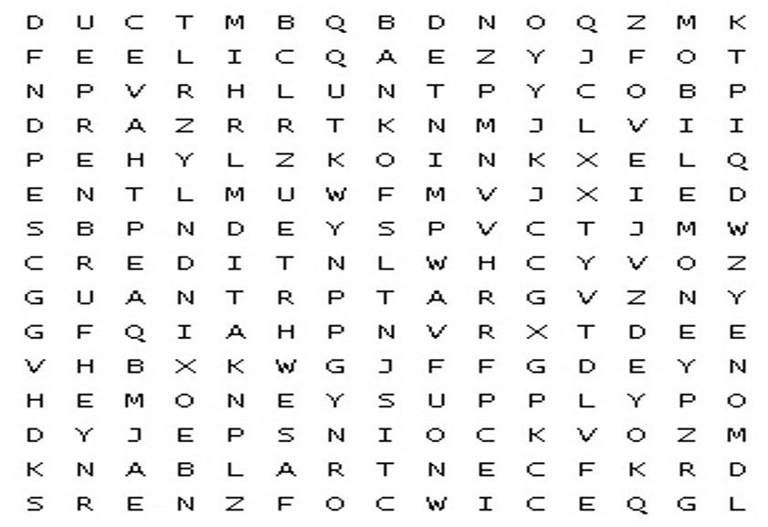
BSL FINANCIAL INCLUSION PUZZLE GAME
The words in this game are extracted from the Financial Inclusion Expert's Corner of the Newsletter (page-9).
BANKOFSL
CENTRALBANK
CREDIT
DEBIT
FEEL
LOOK
MOBILEMONEY
TILT
PRINTED
MINTED
COINS
PAYMENT
EXCHANGE
MONEY
MONEYSUPPLY
UPCOMING FINANCIAL INCLUSION ACTIVITIES
Annual Provider Survey (APS) Report 2022
UNCDF’s Annual Provider Survey is in progress! This survey measures the development of the digital financial services market in Sierra Leone. Stay tuned for the published report!
Financial Inclusion Baseline Survey
BSL to conduct a financial inclusion baseline survey to better measure and monitor financial
inclusion within the country.
Financial inclusion technical working group meetings
Technical working group meetings under the new Strategy will continue to be held.
Restructuring of the Sierra Leone Fintech Association
BSL to embark on the restructuring and re-branding of the Sierra Leone Fintech Association under the implementation of the National Strategy for Financial Inclusion (2022–2026).
Development of MSME Credit Guidelines
The development of Credit Guidelines for MSMEs to improve access to finance is underway.
Development of the BSL Data Committee and Portal
The formation of a committee to enhance the collection, compilation, coordination, dissemination and reporting is underway as well as the development of a data portal.
Strengthening the Fintech Sector in Sierra Leone
BSL to continue to work with key stakeholders and Fintech organizations in the country to promote innovation in the digital finance sector.
Development of a regulation for stand-alone fintechs and guidelines on sustainable finance activities
BSL to continue to work with key stakeholders to develop a stand-alone regulation fintechs and guidelines on sustainable finance activities.
Conduct a Product Mapping Exercise
BSL to conduct a Product Mapping Exercise to determine whether the products offered by the Financial Service Providers (FSPs) are client centric.

Slide 11
Contributors and Appreciat ion Message:
The Financial Inclusion Newsletter initiative would not have been possible without the continued support and guidance from the Governor of the Bank of Sierra Leone, Dr. Ibrahim L. Stevens, and Deputy Governor, Sheikh A.Y Sesay.
Additional thanks to all the Directors at the Bank of Sierra Leone for their input and participation in the Financial Inclusion Newsletter and financial inclusion efforts. Special thanks also to the Alliance for Financial Inclusion (AFI) and UN Capital Development Fund (UNCDF) for their continued support of the Financial Sector Development Unit and the Bank of Sierra Leone over the years.
Financial Inclusion Newsletter encourages its readers to send their contributions based on their experiences in the sector.
For inquiries, comments and/or suggestions on the Newsletter, please email: fkamara@bsl.gov.sl
F I N A N C I A L I N C LU S I O N S E C R E T A R I A T ( F I S )
B a n k o f S i e r r a L e o n e
S i a k a S t e v e n s S t r e e t , F r e e t o w n w w w. b s l . g o v. s l

